Slide 1
WELCOME BACK
Blood Centers of California
March 8, 2016

Slide 2
Welcome
Blood Centers of California
BloodSource Overview
March 8, 2016
Rob Van Tuyle
Chief Executive Officer

Slide 3
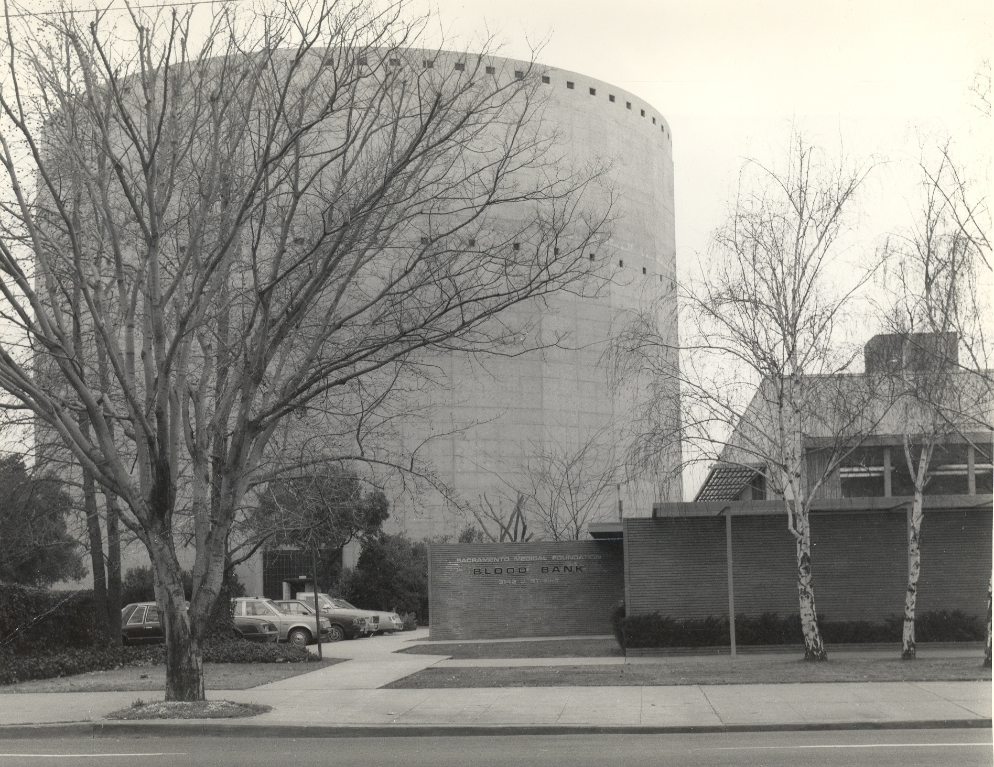

Slide 4
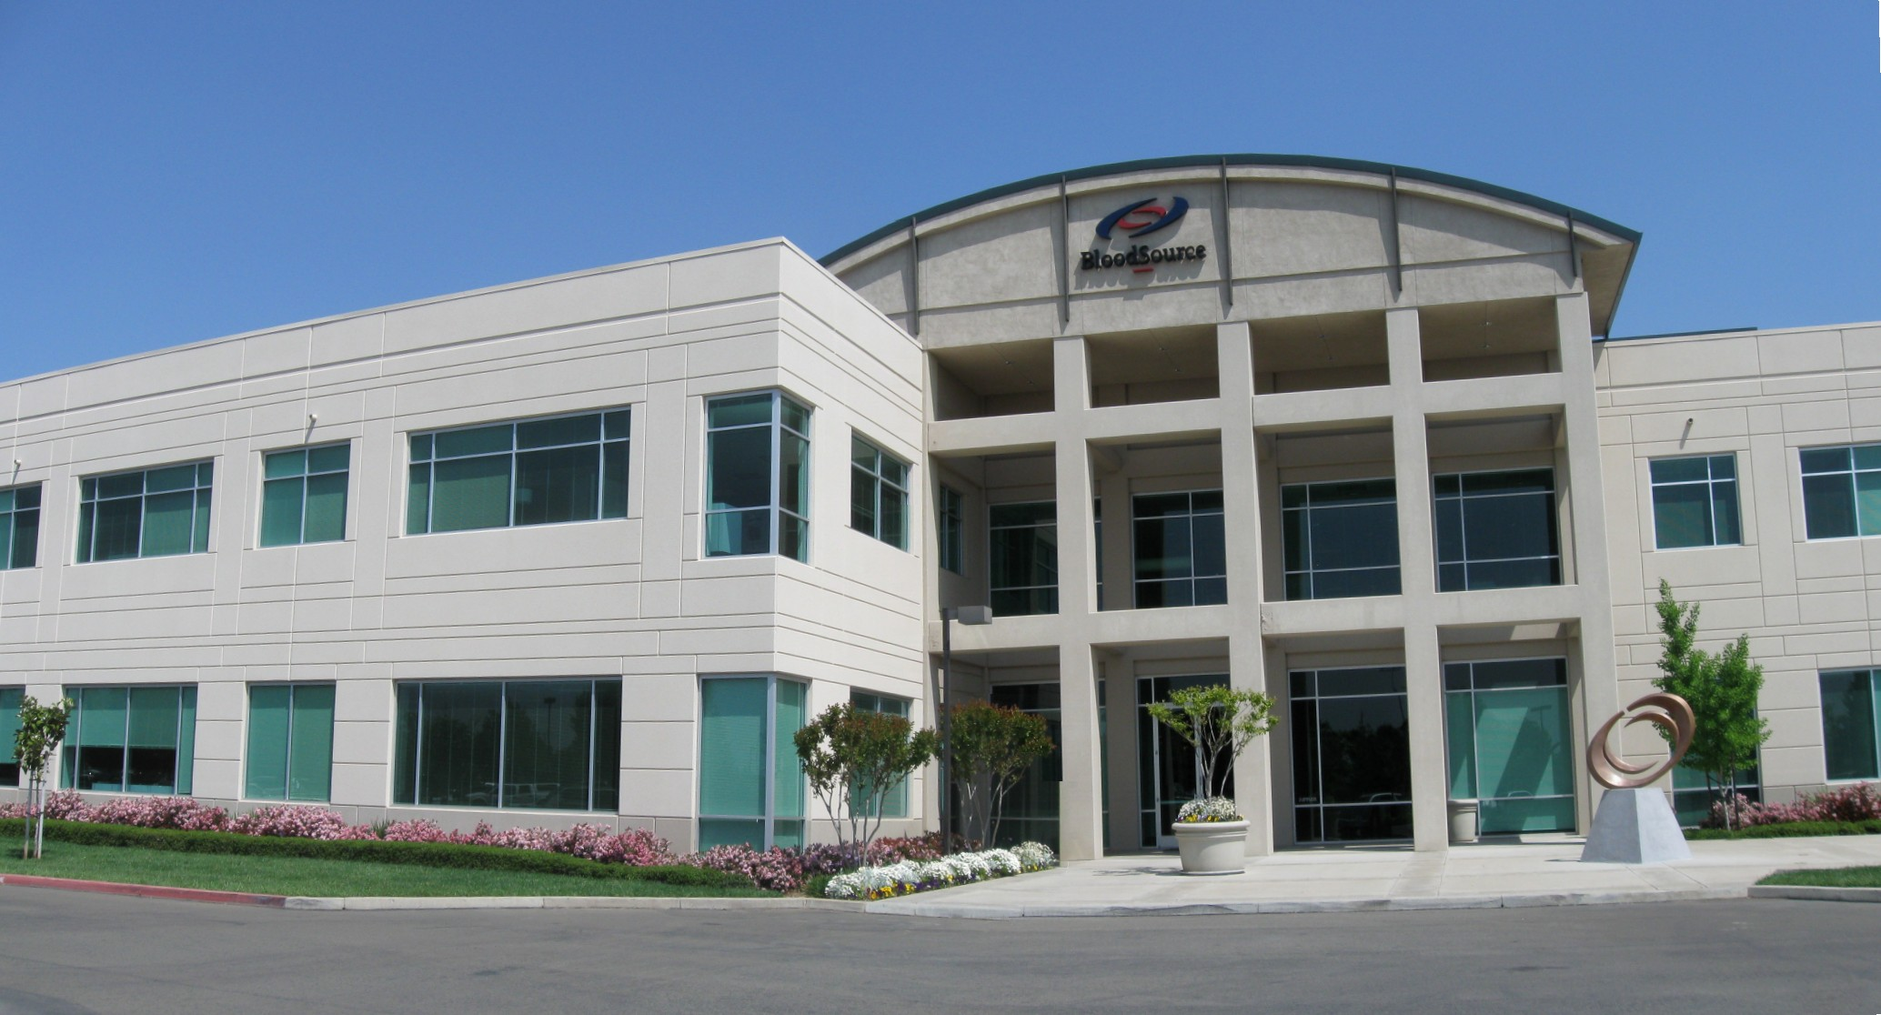
BloodSource Today

Slide 5
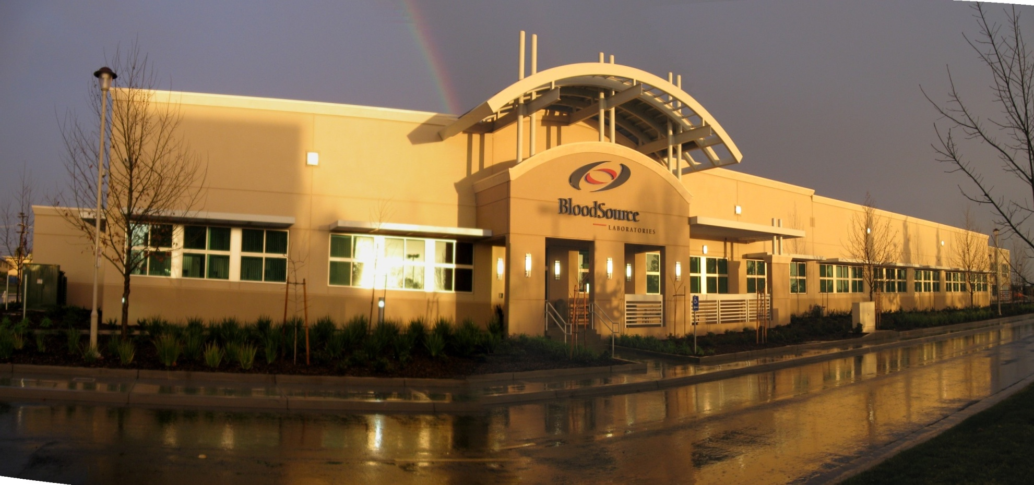
BloodSource Laboratory

Slide 6
Merger with BCP/BSI
Blood Systems, Inc.
Sierra Sacramento Valley Medical Society
Blood Centers of the Pacific
BloodSource

Slide 7
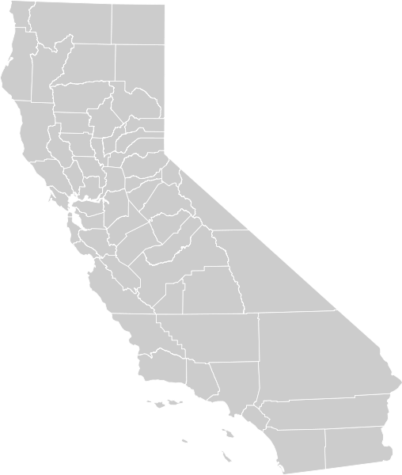
Community-based
Not-for-profit since 1941
Volunteer blood donors
Distribute 400,000 units/year
Serve 37 counties
Serve 95 hospitals
Serve 13 million residents
Regional center in San Francisco
21 community donor centers
22 bloodmobiles
Accredited by AABB
Inspected by State of California, FDA, AABB, and European Union
~ 720 employees
Offer autologous, patient-directed & cellular therapy blood collection services

Slide 9
PRODUCTION/COLLECTIONS

Slide 10
Automation Focus
Notes:
Automation focused organization
Moving donors from lower demand/lower margin RBCs to high demand/higher margin components
Look at every donor for future automated donation; they are the pipeline to feed the higher margin components
Gender, blood type, vein assessment, TBV, geography, etc …
We have great success --- company-wide initiative for many years
DONOR CONVERSION – continue to enhance our program

Slide 11
Transfusable Plasma Program
All male donor base
Collect via automation
Frequent donor program
AB male recruitment efforts
Distribute 2/3 FFP-J and 1/3 FFP-A
Recovered plasma to fractionation
Notes:
Like SP donors; total protein, annual physical and SPE (The serum protein electrophoresis (SPE) test measures specific proteins in the blood)
RNs have been trained as Physician Substitutes to perform the annual physicals for our frequent plasma donors (and SP donors)
Nearly all plasma from whole blood is RP and sent for further manufacturing

Slide 12
BloodSource End-of-Month Split Rate
Notes:
1. 9/24/12 Default Dose Range change in Vista. Suboptimal= 0.0 to 2.9; Platelet 1 = 3.0 to 6.2. Also, new PAD procedure implemented.
2. 10/11/12- (1:00pm) turned off Rh+ automated RBCs
3. 10/18/12- YSF changed from 1.12 to 1.10. On 10/19/12- Reinstated 10.5 triple target, deleted 7.1 double target.
4. Onsite conversions and recruitment of WB to PP was suspended on 12/4.
5. Conversions were reinstated as of 12/20.
6. All 3 Micros recalibrated on 01/29/13.
7. Began discarding High and Low Platelet Concentrations collections due to non-compliance with storage bag recommendation as of 4/9/2013. Previously these products were labeled and license struck.
8. All 3 Micros 60s are undergoing their annual PM and then subsequent semi-annual Calibration this evening. All MPT collections from 6/25/13 and later will be tested using the recently PM’s and Calibrated instruments. Since all apheresis platelet data is entered into Vista lab module MPM will be able to access all necessary information needed to evaluate YSF – 06/25/2013.
9. Trima YSF changes were made effective 12/03/2013.
10. All 3 ABX Micros 60’s calibrated on 12/09/2013.
11. Trima Maximum Draw Flow changed from Moderate to Fast effective 4/1/2014.
12.All 3 ABX Micros 60’s calibrated on 06/17/2014.

Slide 13
Collections
Notes:
RBC demand declines, continue to engage donors by conversion to automation
Lower cost imports supplement our RBC inventory, allows for the automation focus.
Currently, we are a platelet machine and would like to keep that engine running
Source plasma is also gaining traction and growth. (Moved FP to SP)

Slide 14
CUSTOMERS

Slide 15
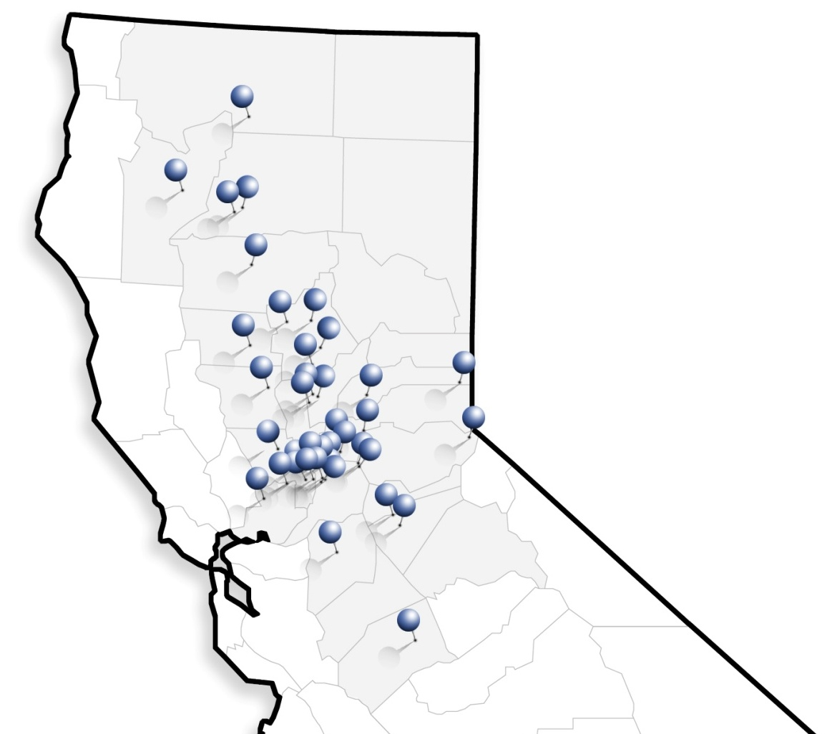
Who BloodSource Serves
Sutter Health
Sutter Amador Hospital
Sutter Auburn Faith Hospital
Sutter Davis Hospital
Sutter General Hospital
Sutter Memorial Hospital
Sutter Roseville Medical Center
Sutter Surgical Hospital North Valley
Sutter Solano Medical Center
Sutter Memorial Medical Center Modesto
Sutter Tracy Community Hospital
Dignity Health
Mark Twain St. Joseph’s Hospital
Mercy General Hospital
Mercy Hospital of Folsom
Mercy San Juan Medical Center
Mercy Medical Center Merced
Mercy Medical Center Redding
Mercy Medical Center Mt. Shasta
Methodist Hospital of Sacramento
Sierra Nevada Memorial Hospital
St. Elizabeth Community Hospital
St. Joseph’s Medical Center
Woodland Healthcare
Kaiser Permanente
Kaiser Permanente Medical Center North
Kaiser Permanente Medical Center South
Kaiser Permanente Medical Center Roseville
UC Davis Medical Center
Other
Barton Memorial Hospital
Biggs-Gridley Memorial Hospital
Colusa Regional Medical Center
Enloe Medical Center
Feather River Hospital
Fremont Medical Center
Glenn Medical Center
Kindred Hospital Sacramento
NorthBay Medical Center
Oroville Hospital
Patients’ Hospital Redding
Rideout Memorial Hospital
Shriners Hospital for Children of Northern California
Trinity Hospital
VA Medical Center of Sacramento
VacaValley Hospital
Notes:
Locally, BloodSource serves 42 hospitals throughout Northern CA.
BloodSource serves each of the 4 major hospital systems in the Sacramento area (Dignity Health, Sutter Health, Kaiser Permanente and UCD).

Slide 16
Who BCP Serves
Sutter Health
Alta Bates Summit Medical Center - Alta Bates Campus
Alta Bates Summit Medical Center - Summit Campus
California Pacific Medical Center - California
California Pacific Medical Center - Davies
California Pacific Medical Center - Pacific Campus
California Pacific Medical Center - St. Luke's Campus
Eden Medical Center
Novato Community Hospital
Mills-Peninsula Medical Center
Sutter Delta Medical Center
Sutter Lakeside Hospital
Sutter Santa Rosa Regional Hospital
Dignity Health
Dominican Hospital
Saint Francis Memorial Hospital
Sequoia Hospital
St. Mary's Medical Center
Kaiser Permanente
Kaiser Antioch
Kaiser Redwood City
Kaiser San Francisco
Kaiser San Rafael
Kaiser Santa Rosa
Kaiser South San Francisco
Kaiser Vacaville
Kaiser Vallejo
Kaiser Walnut Creek
Military/Government Facilities
David Grant Medical Center
VAMC - Ft. Miley
VAMC Martinez Outpatient Clinic
St. Joseph Health Facilities
Petaluma Valley Hospital
Queen of the Valley Medical Center
Santa Rosa Memorial Hospital
Other
Chinese Hospital
El Camino Hospital - Los Gatos
El Camino Hospital - Mountain View
Fairchild Medical Center
Healdsburg District Hospital
Marin General Hospital
Mayers Memorial Hospital District
Mendocino Coast District Hospital
Modoc Medical Center
San Francisco General Hospital
San Mateo Medical Center
Seton Medical Center
Shasta Regional Medical Center
Sonoma Valley Hospital
St. Rose Hospital
Surprise Valley Hospital
Academic Facilities
UCSF Benioff Children's Hospital & Research Center Oakland
UCSF-Mission Bay Plaza
University of California at San Francisco
University of California at SF-Mt Zion Campus
Notes:
Locally, BloodSource serves 42 hospitals throughout Northern CA.
BloodSource serves each of the 4 major hospital systems in the Sacramento area (Dignity Health, Sutter Health, Kaiser Permanente and UCD).

Slide 17
Clinical Laboratory Services
Reference laboratory:
11 FTEs
$2M Revenue
HLA laboratory:
20 FTEs
$7M Revenue

Slide 18
OTHER INITIATIVES

Slide 19
What is BloodSmart®?
“A three tiered comprehensive blood management program designed to improve patient safety and to reduce costs related to blood utilization in the hospital.”
Also includes:
Enhanced physician driven consultative and web resources
Increased cost savings and optimal patient care
Notes:
Blood management program
Assessment
Assessment & Website Access
1 and 2, plus physician support and guidance

Slide 20
AdvancingBio
A division of BloodSource that collects, tests, processes and distributes a human derived biologic product (FMT) to physicians for treatment of patients with Clostridium difficile infection (C. diff)
Notes:
Very similar to what we do at BloodSource –
Fecal microbiota transplantation for the treatment of C. diff
347,000 cases of Clostridium difficile (C. diff) /year
15,000 patients die/year
Antibiotics are expensive and don’t always work
FMT has a success rate over 90%

Slide 21
Source Plasma
Notes:
A long awaited program for us, Source Plasma from Volunteer Donors

Slide 22
Growing market
Repurposing whole blood donors
Leverage existing core competency
Secured long-term contract with LFB (France)

Slide 23
Total Collections
Notes:
~800 Mls per donation

Slide 24
Global Reach
Notes:
BloodSource serves the global community.
Our plasma is fractionated in Europe to produce life saving medicines used across the world.

Slide 25
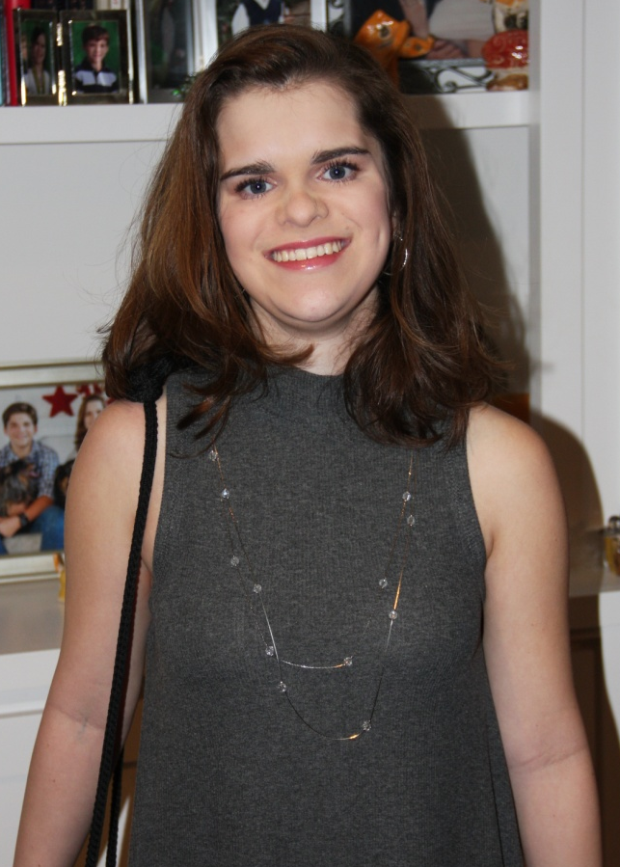
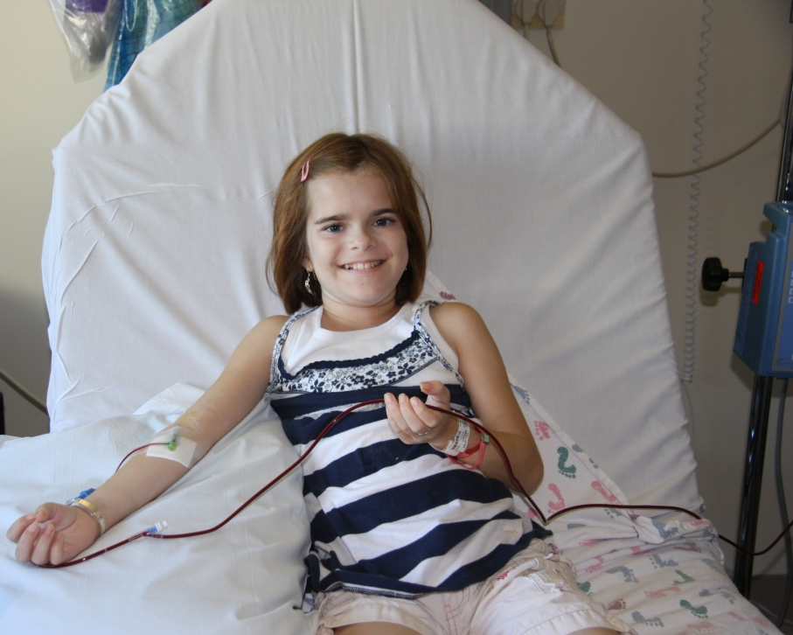
Abby Fitzpatrick
Need for blood: Crohn’s
Blood Products: Red blood cells
Blood Type: O-
17 years old
8 years old

