Slide 1
HOT STUFF
BCC Board Meeting
City of Hope
September 28, 2015

Slide 2
Overview
Update for BCC Board Meeting
Opportunity to discuss issues not on agenda and not covered by a featured speaker
SNL COFFEE TALK – We’ll Talk - No Big Whoop

Slide 3
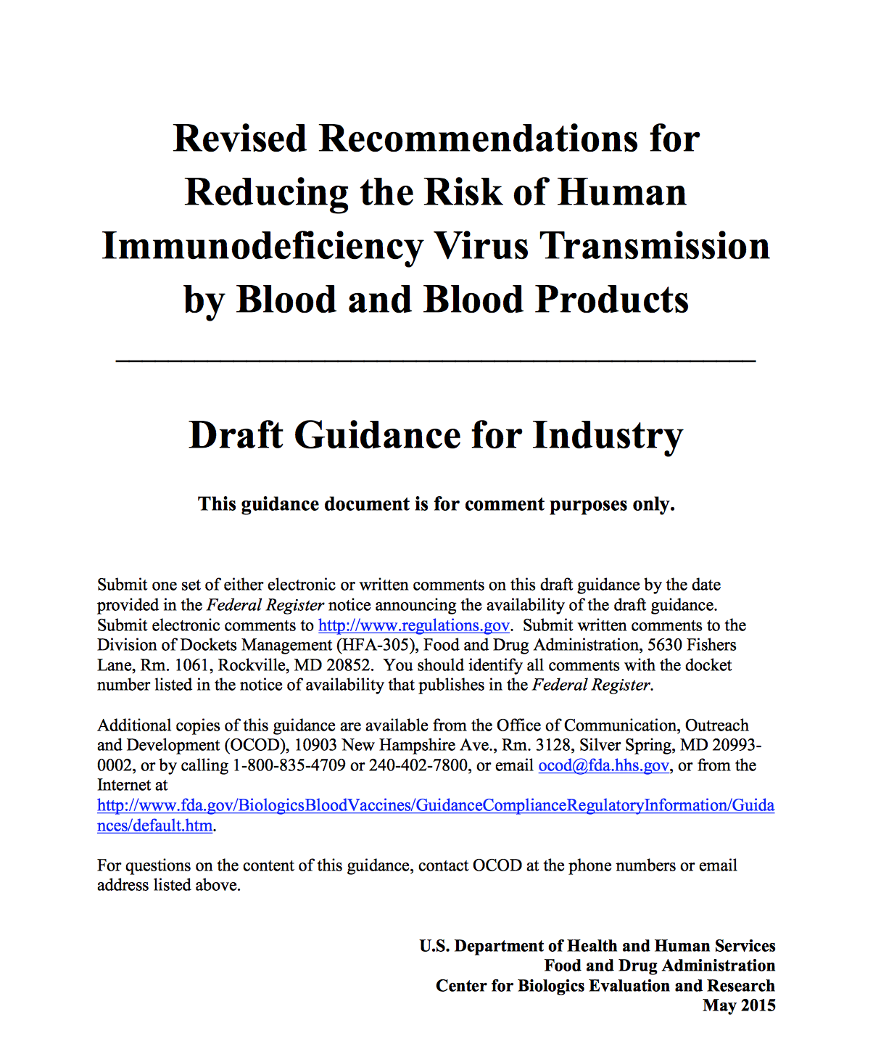
MSM Draft Guidance – May 2015
12 month deferral for MSM replaces lifetime deferral
Gender self reported, but MD make policy
Final guidance before implementation

Slide 4
MSM
Plan of attack???

Slide 5
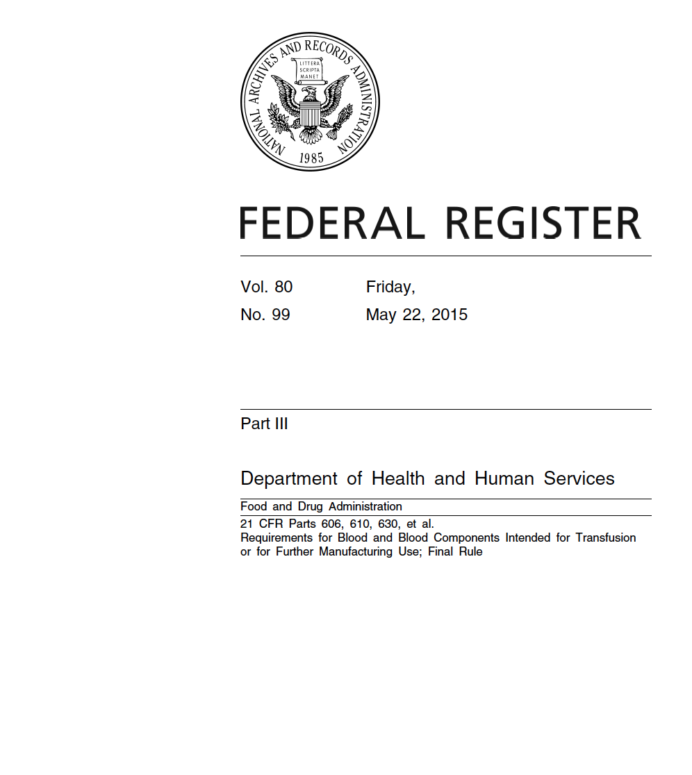
CFR: Requirements
May 2016
Male Hb >= 13
Female Hb >= 12.5 or 12 if mechanism
Bacterial contamination mitigation formalized
Medical oversight requirements
AABB FDA Liaison Committee recently met to discuss the new rule (9/25/15 AABB WR)

Slide 6
The New Rule
What to do???

Slide 7
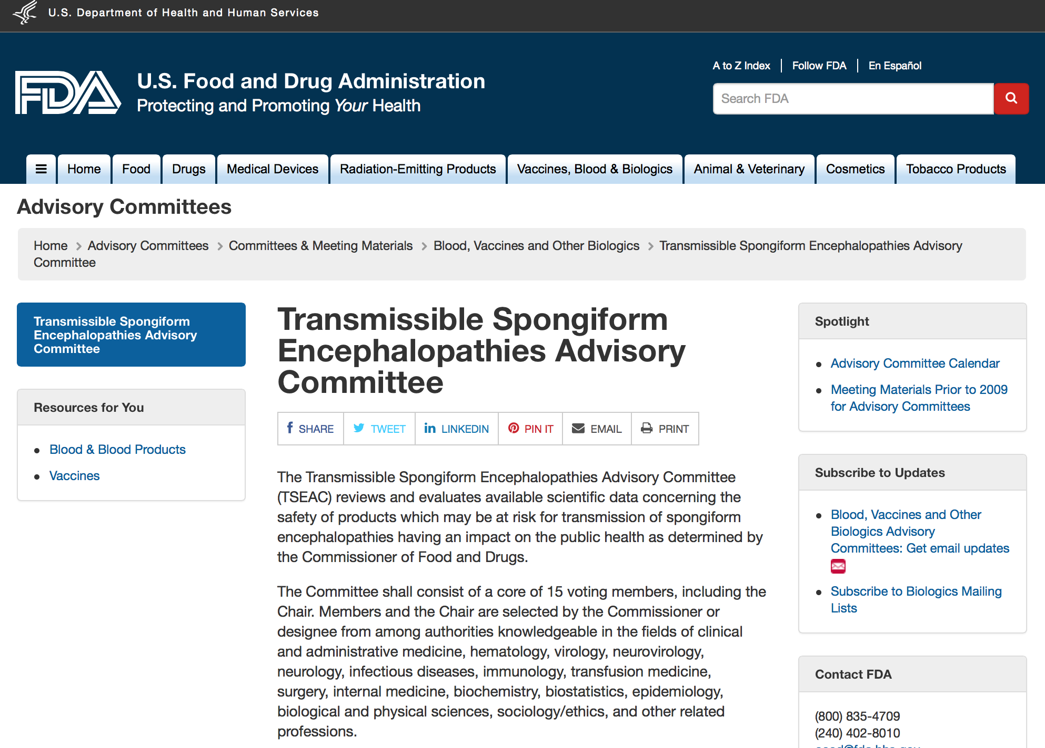
vCJD Deferral
Transfusion Spongiform Encephalopathies Advisory Committee (TSEAC) met June 2015
FDA recommended limiting residency restrictions, but TSEAC voted against a more lenient option
TSEAC also recommended universal leukoreduction

Slide 8
Pathogen Reduction
We’ve had multiple presentations from CERUS on INTERCEPT PR System
PR-Platform approved for Apheresis Platelets and for Plasma ( Dec 2014)
Interim language for Circular of Information developed by AABB COI Task Force/FDA liaisons
PROS: Additional Safety, possible 7 day platelet
CONS: $$$$, No triples, Tight collection range for doubles, Not all organisms (HAV, HEV)

Slide 9
Pathogen Reduction
Talk amongst yourselves…

Slide 10
Babesia – BPAC May 2015
BPAC Recommendations
  Nation-wide year round testing for Babesia-risk by an antibody-based test
    11 yes; 3 no
  NAT-based testing should be performed in certain high-risk states
    14 yes; 0 no
      9 states – 8 votes
      15 states – 6 votes
  2 year deferral period for those with positive results

Slide 11
Babesia - BPAC
Should FDA BPAC determine policy since it does not consider cost-effectiveness?
  Dr. Katz (ABC) recommends HHS Advisory Committee on Blood and Tissue Safety and Availability
    Broad stakeholder engagement including payers (including CMS), hospital administrators, transfusing clinicians outside of transfusion medicine, patient advocates, bioethicists, and healthcare economists

Slide 12
Molecular Testing for RhD
Joint Statement on Phasing-In RHD Genotyping for Pregnant Women and Other Females of Childbearing Potential with a Serologic Weak D Phenotype
  AABB and CAP
  Concerns
    Cost (although arguments that this is cost neutral)
    Implementation issues; accepting report performed once; ROI only
    Liability concerns

Slide 13
Odds and Ends
Robert Califf nominated as new FDA Commissioner to succeed Margaret Hamburg
Medicare Outpatient Proposed Rule
  Severe cuts in payments for blood products
  30% for LR RBCs
  Joint statement AABB, ABC, ARC (Aug 31, 2015)
Tattoos and donor eligibility

