Slide 1
Pathogen Reduction An Implementation Story…
Kim Duffy, Scott Hammel, Justin Kreuter

Slide 2
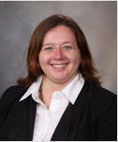
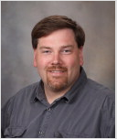
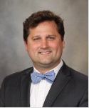

Slide 3
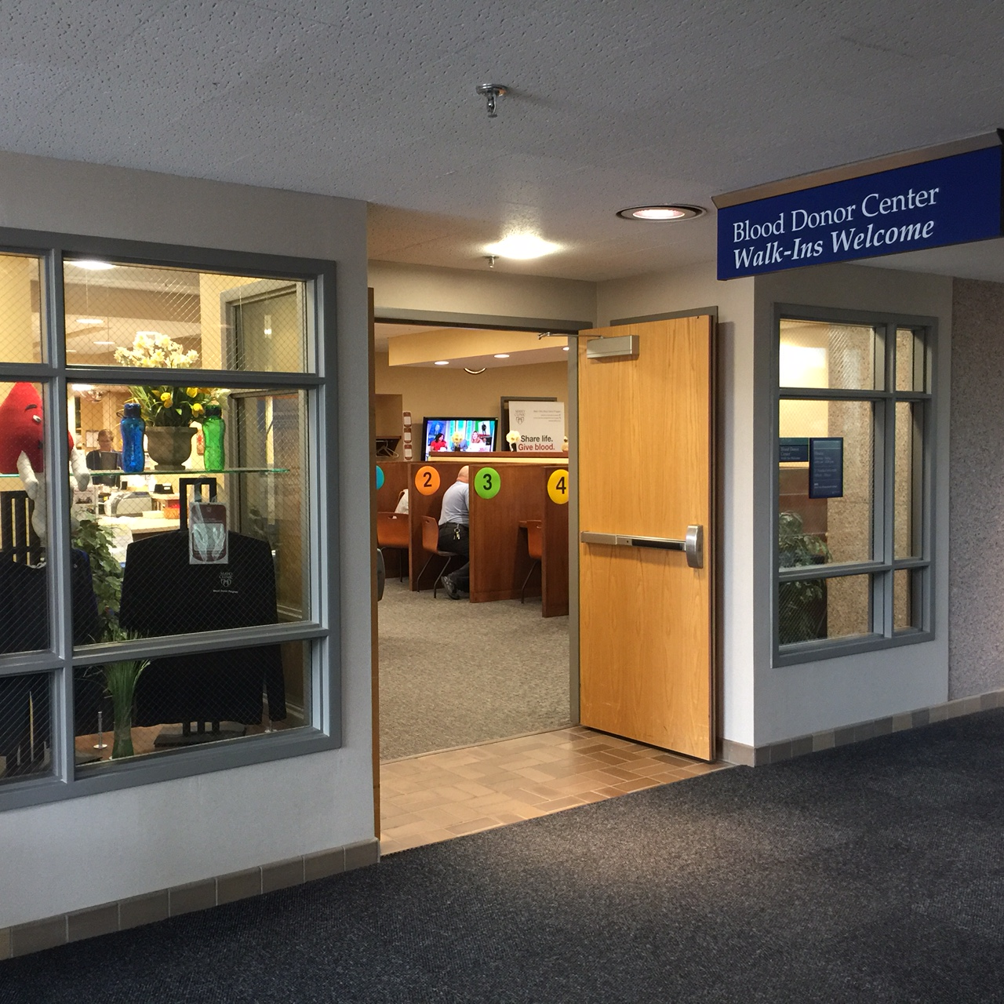
Collections – 2016
RBCs 21000
Plts 4000
DR 1000
WB 100
AP 134

Slide 4
The Decision

Slide 6
Targets
400 mL
7 x10^11
6.8 x10^11
300 mL
4.2 x10^11
4.0 x10^11
3.5 x10^11

Slide 8
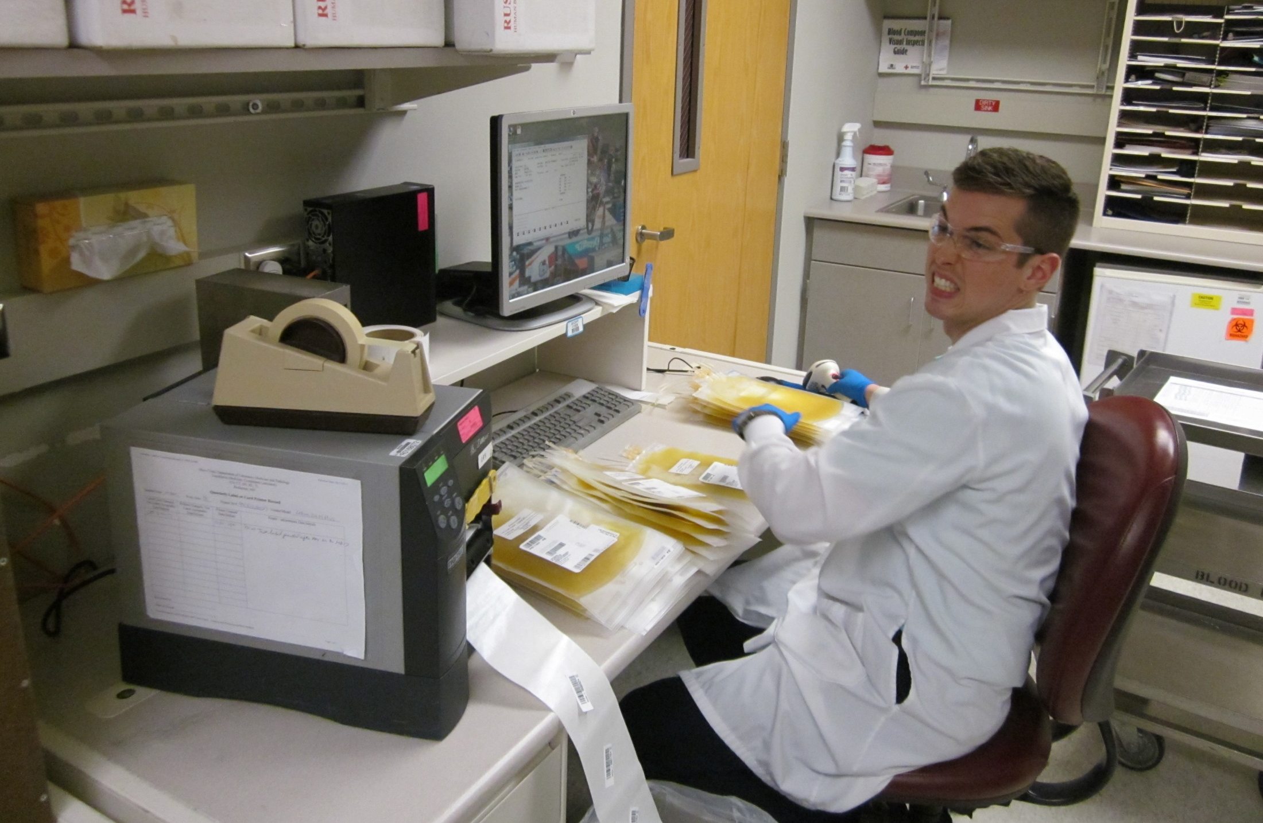
Meanwhile in the lab…

Slide 9
~19 /day
Business Objects
Flags?
Mods?
LIS
10am

Slide 10
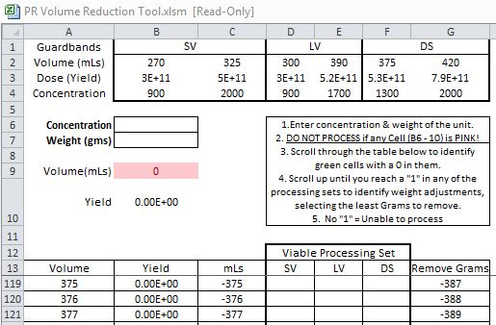

Slide 11
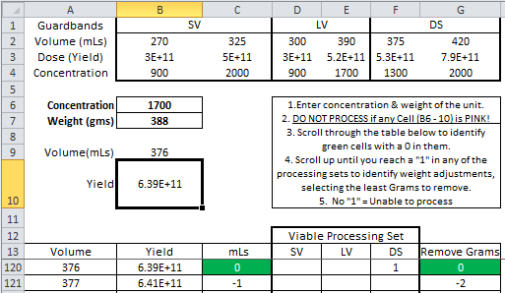

Slide 12
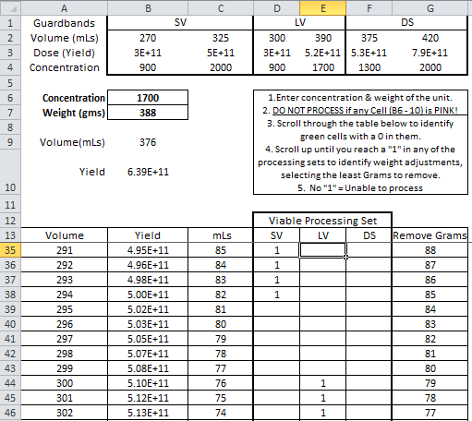

Slide 13
Another example…

Slide 14
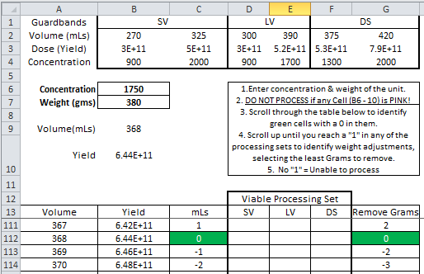

Slide 15
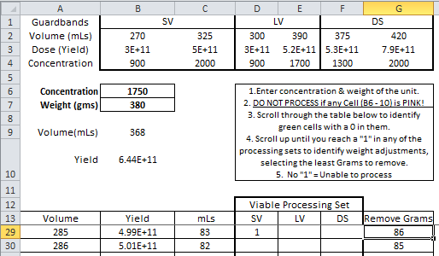

Slide 17
3.2%
Unable to process
10%
Platelet loss to processing
Stable
Platelet counts relative to time in CAD

Slide 18
Meanwhile in the clinic…

Slide 19
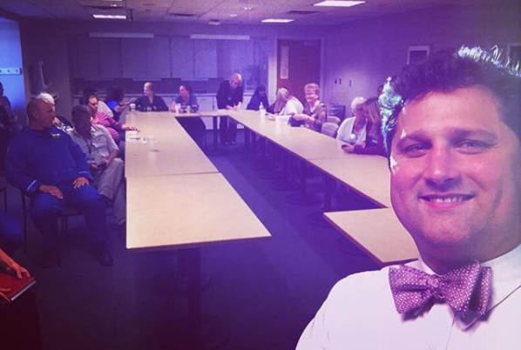

Slide 20
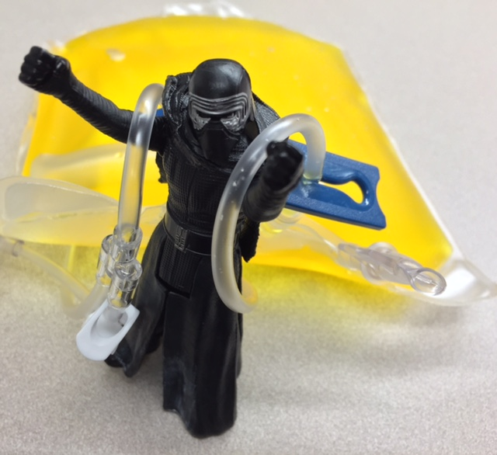

Slide 23
Questions & Discussion Kreuter.Justin@Mayo.Edu

